Slide 1
Oslc Product Domain
PTC
January 2023

Slide 2
Agenda
Windchill PLM configuration management practices (20 mins)
Summary of current PTC implementation (15 mins)
Feedback and Current limitations (15 mins)

Slide 3
PLM – HOLISTIC Product Definition
Parts are the foundation for product definition in the Digital Thread
Enable associations to
CAD (MCAD/ECAD)
Documents
Visualization
Dynamic Documents
Change processes
Quality processes
Requirements & System Models (OSLC)
Process Plans
And more…
Part 123 - A.2 (In Work)
Used By
And can be associated to
Related to
CAD Documents
Dynamic Documents
Uses
Documents
Change Items
Requirements (OSLC)
Process Plans

Slide 4
Configuration Management – PLM Concepts
What is a Part Master?
A database object that records information about Parts that does NOT change with the creation of new revisions
What is a Part Version?
A database object that records information unique to a specific point in a Part’s design life cycle
Caries a version designator such as “A” or “1”
References Windchill Documents which are unique to that version such as:
Specifications
CAD models
123 – Part Name
A.3
123 – Part Name
A.3
123
Part Master
123
A
123
B.2
Part Versions
123
A
123
B.2
123
A.3

Slide 5
PLM Configuration Management
How does Windchill know which Versions to show in the BOM?
Which of these Part Versions is the latest with state “Released?”
1
Released
1
A
1
B
In Work
4
5
6
4
7
6
Released
5
A
5
B
Released
7
A
In Work
8
9
10
9
11
12

Slide 6
PLM Configuration Management
Which of these Part Versions is the latest with state “Released?”
1
Released
1
A
1
B
In Work
4
5
6
4
7
6
Released
5
A
5
B
Released
7
A
In Work
8
9
10
9
11
12
The product structure navigator walks from the top of the tree to the bottom, selecting the appropriate Part Version.

Slide 7
PLM – Linking Data
Several common patterns to link related data in Windchill
Version Specific Relationships – “Described by”
The Relationship holds information about the Versions on both sides of the link
Making changes to the Versions requires explicit action – for example manual update, or update via change process
Version Independent Relationships – “References”
The Relationship always points to the Latest Version of the related item
The user will always see the latest version of this and does not have to do any additional actions
Can use a Configuration Specification such as Baseline or Effectivity to determine a specific version (as long as there is a valid link)
There are other relationship types such as Master and Revision, but are not as common in these types of use cases

Slide 8
Extending Concepts to OSLC Traceability
ALM applications in general support Branch and Copy models
MBSE tools have both concepts
(Depending upon vendor and domain)
Trace links can have different behavior
PTC will support the ability for configure Trace links to communicate configuration information
A valid link must exist for configuration information to be valid between systems
Augment OSLC to communicate configuration information
Support updating links manually, via Change process or Programmatically
Enable additional configuration concepts to be supported
Share Baseline information across systems
Leverage concepts such as State or Effectivity where appropriate
Requirements Domain
Part/Product Domain
Part 1 (Master)
Req 1, A-1
Rev A.1
Change
Rev A.2
Req 1, B-1
Req 1, B-2
Rev B.1
Link is created / updated based upon explicit action such as a Change or via rules

Slide 9
Effectivity
Determines when a Part Revision is planned to be ”Used in Production”
Three kinds of effectivity
Date (global or effectivity context)
Lot (requires effectivity context)
Serial Number (requires effectivity context)
Able to enter both a beginning and ending parameter
Date => 01/31/2009 – 12/31/2010
Unit => 001-020
Configuration Specification used to expand a product structure according to effectivity

Slide 10
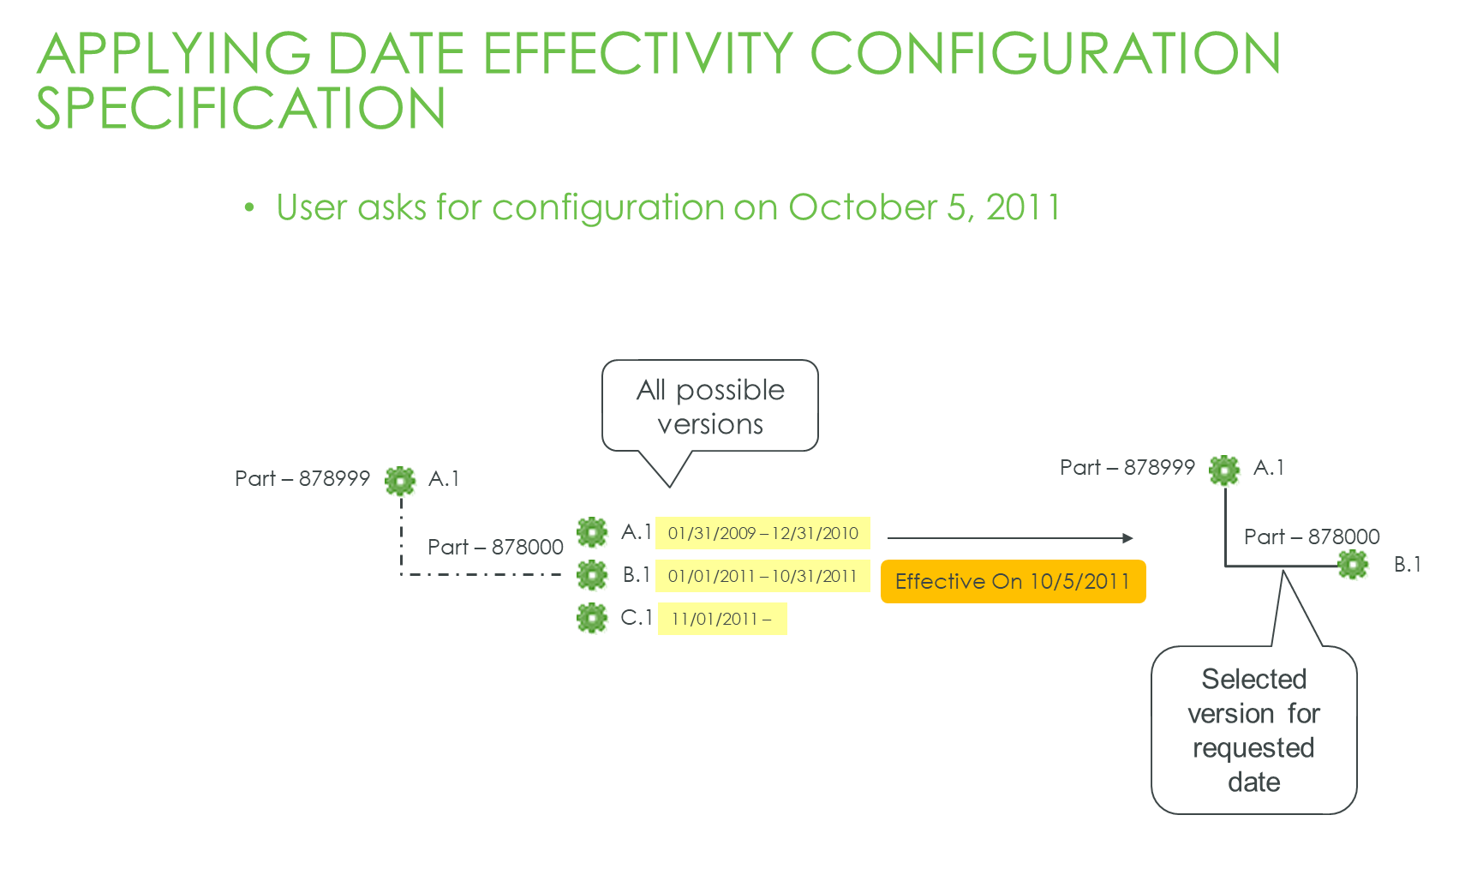

Slide 11
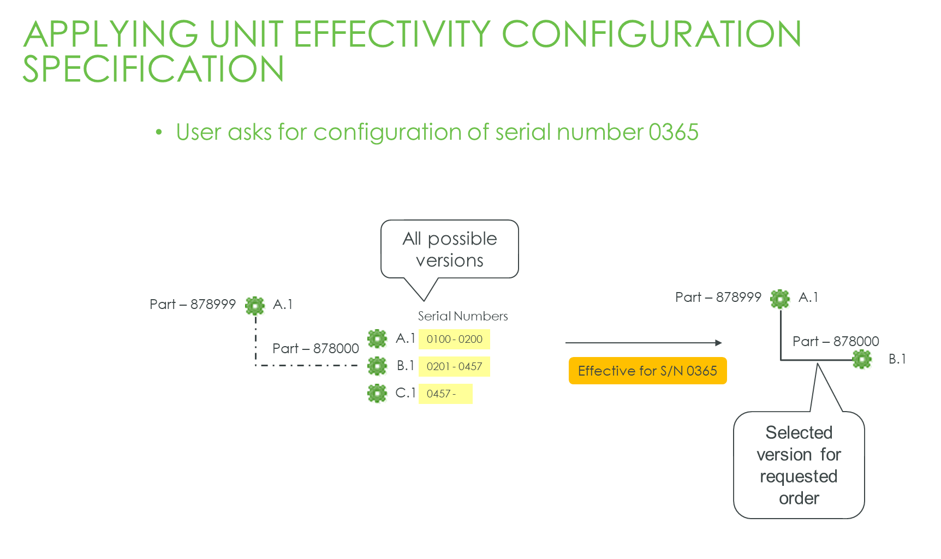

Slide 12
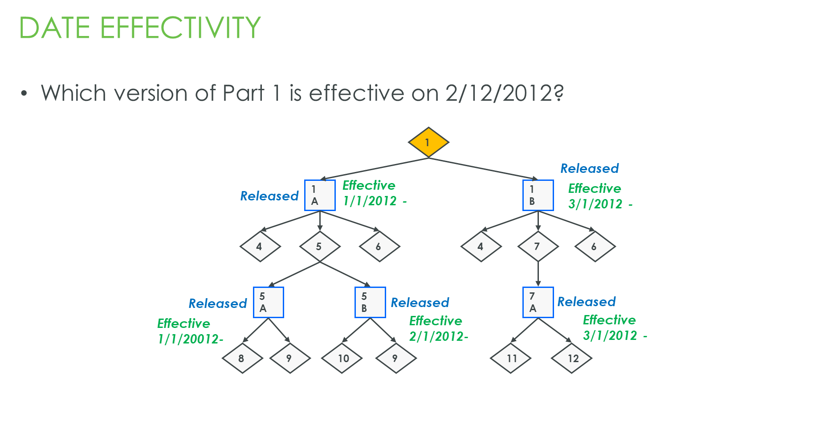

Slide 13
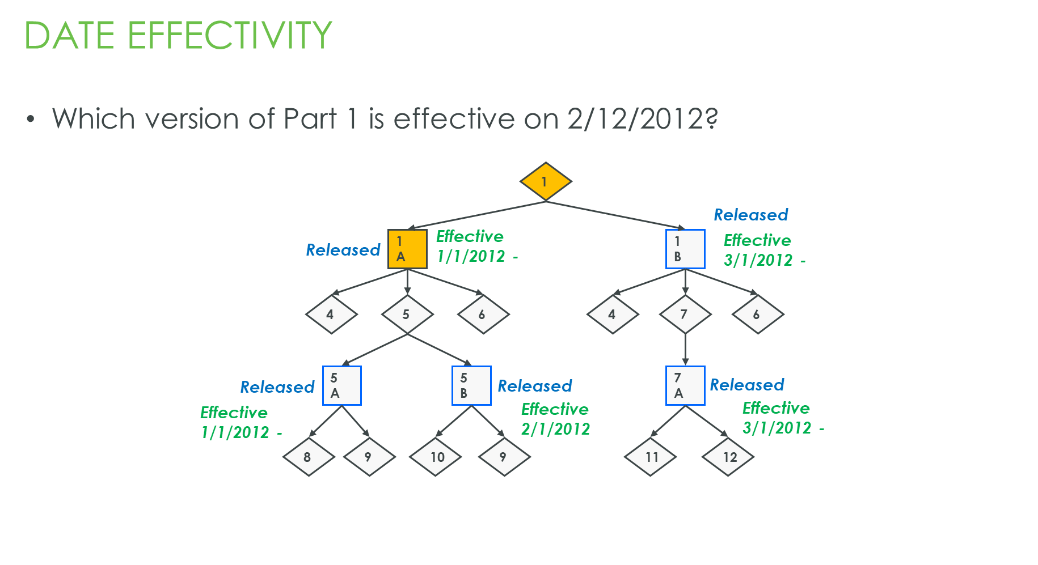

Slide 14


Slide 15
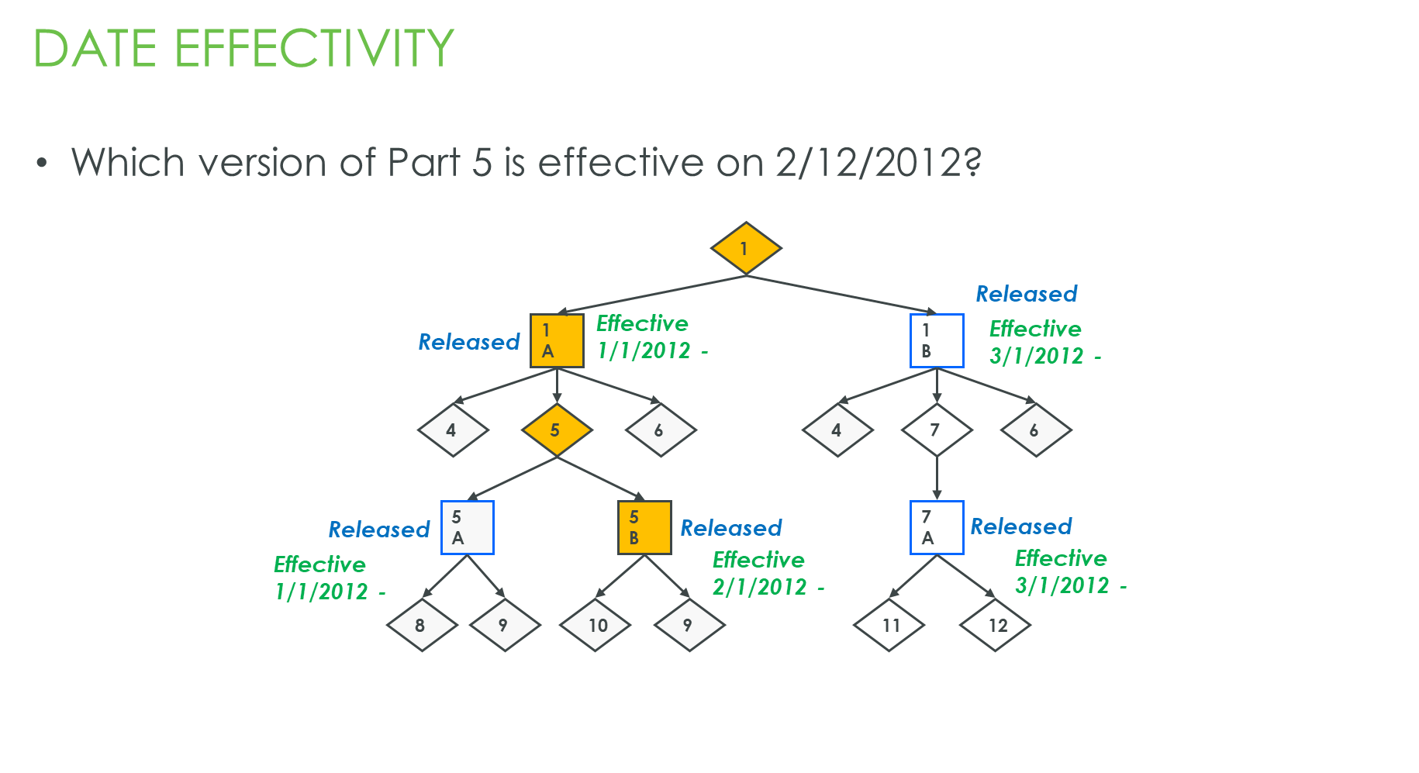

Slide 16

PLM Linked Data
Version-To-Version Links
Describes
A.1
A.2
B.1
A.1
A.2
A.3
B.1
To Link to Version B.1 explicit action must be taken
Reference
A.1
A.2
A.3
B.1

Slide 17




Agenda
Windchill PLM configuration management practices (20 mins)
Summary of current PTC implementation (15 mins)
Feedback and Current limitations (15 mins)

Slide 18
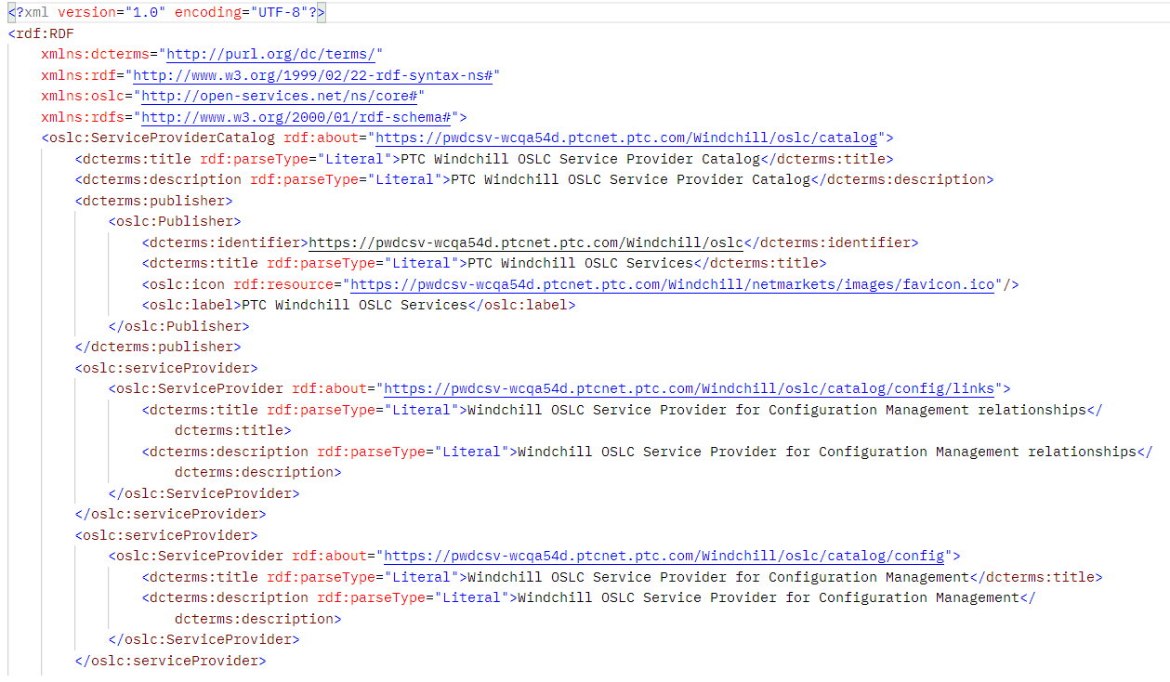
Windchill as OSLC server
https://pwdcsv-wcqa54d.ptcnet.ptc.com/Windchill/oslc/catalog

Slide 19
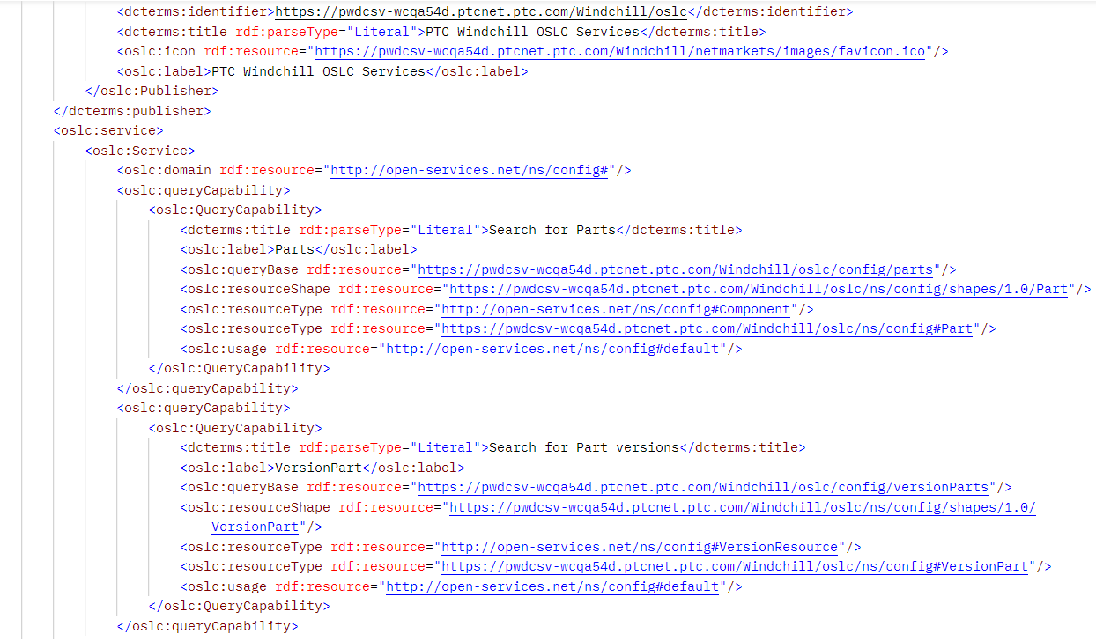
Windchill OSLC services
https://pwdcsv-wcqa54d.ptcnet.ptc.com/Windchill/oslc/catalog/config

Slide 20
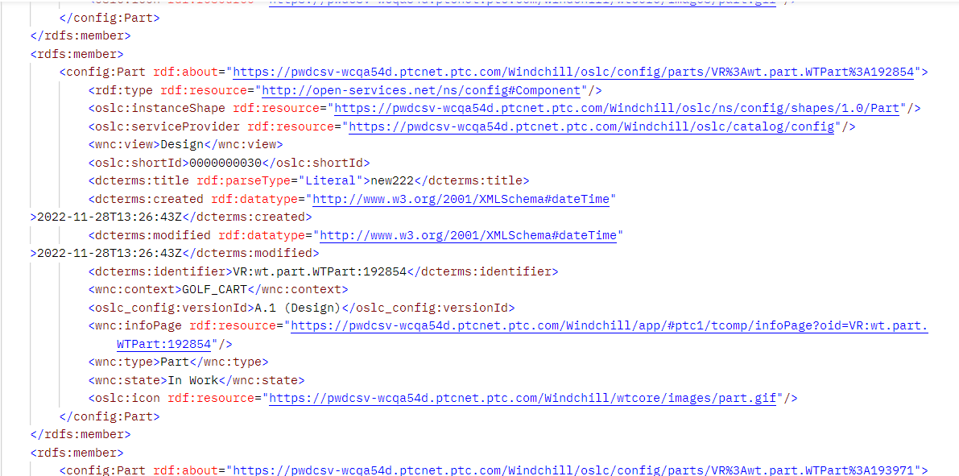
SEARCH FOR PARTS
https://pwdcsv-wcqa54d.ptcnet.ptc.com/Windchill/oslc/config/parts

Slide 21
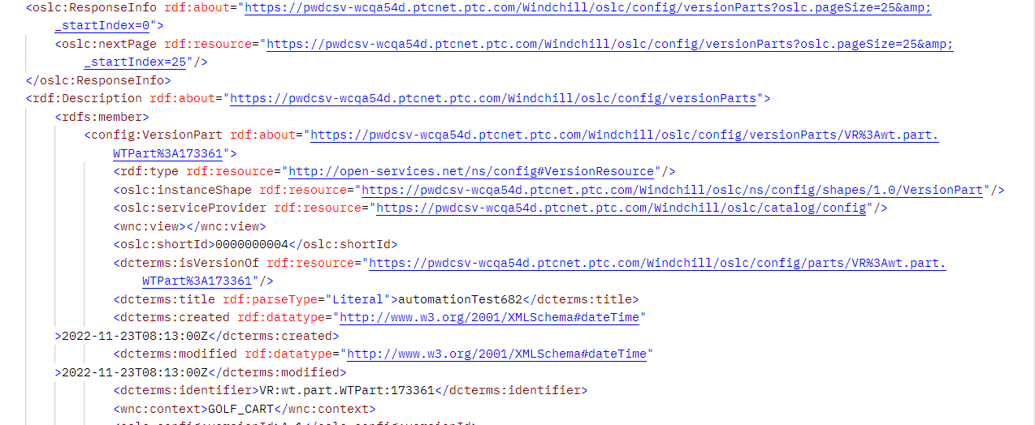
SEARCH FOR PART versions
https://pwdcsv-wcqa54d.ptcnet.ptc.com/Windchill/oslc/config/versionParts

Slide 22
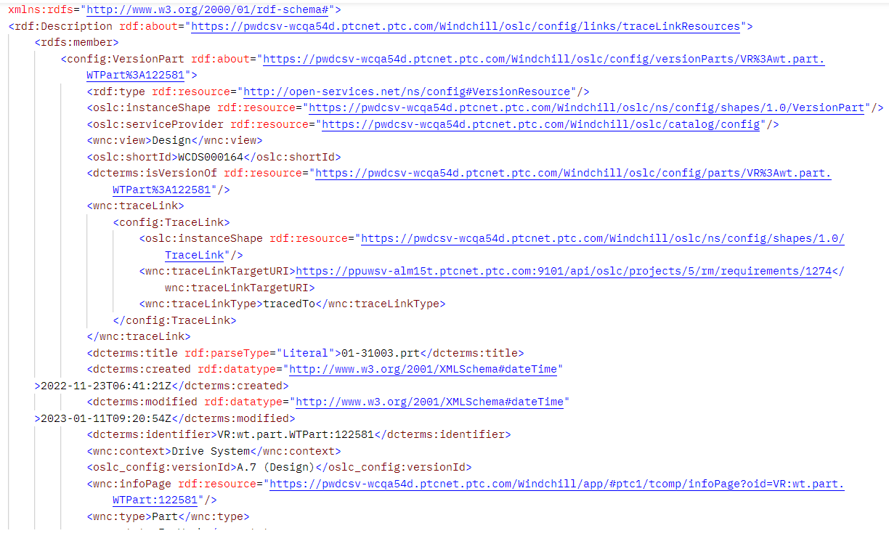
Reverse look-up service
https://pwdcsv-wcqa54d.ptcnet.ptc.com/Windchill/oslc/config/links/traceLinkResources?oslc.where=wnc:traceLinkTargetURI=https://ppuwsv-alm15t.ptcnet.ptc.com:9101/api/oslc/projects/5/rm/requirements/1274

Slide 23
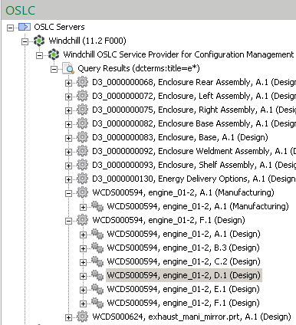
how Modeler OSLC Client links to Windchill PLM parts
All Windchill Part versions are available for linking
OSLC Links created using ‘parts’ will be version-independent
i.e. always point to the latest version
OSLC Links created using ‘part versions’ will be static and version-specific
i.e. always point to a certain version
Part (defaults to latest version)
All part versions

Slide 24
Agenda
Windchill PLM configuration management practices (20 mins)
Summary of current PTC implementation (15 mins)
Feedback and Current limitations (15 mins)

Slide 25
Poor PLM COVERAGE IN OSLC
No dedicated representation for PLM part information in OSLC (other than the Architecture domain which was deemed too generic)
forcing vendors to use inappropriate OSLC domains
which leads to poor quality data
which leads to poor quality integrations

Slide 26
Poor UX, Weak Support for CM
PLM Parts and part versions are accessed one at a time
Painful…
No structure information served up
Only see 1 small slice of the product
OSLC lacks clarity on parent/child relationships for a eBoM view

Slide 27
Weak Support for CM
No configuration management-based filtering possible as PLM Config Mgmt concepts not supported in OSLC.
Would like to be able to set the Configuration Specification when accessing a part structure via OSLC.
Similar to setting the Global Configuration when accessing DOORS resources

Slide 28
QUESTIONS?

Slide 30
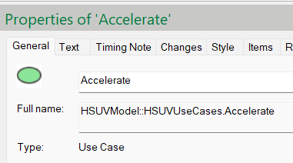
Config mgmt. - Modeler
Windchill Modeler items do not have a number or ID that is exposed to users
They are identified by the
Type
Name
Scope (Package location)
Full name (Scope.Name)
All model items (including packages and diagrams) have an internal ID called a GUID
This is not directly visible to users

Slide 31
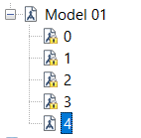
Config mgmt. - Modeler
Windchill Modeler manages versions at the model level
Individual items have versions, but are not exposed to users
The latest model version (also called the tip) is writable
Old versions are locked, and act as baselines

Slide 32
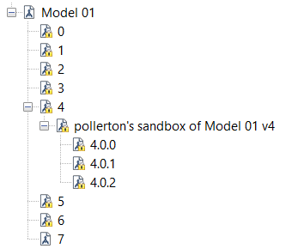
Config mgmt. - Modeler
Windchill Modeler provides the ability to branch a model – called a private sandbox
Model items can be changed in isolation, then reconciled (merged) to the main model (trunk)

Slide 33
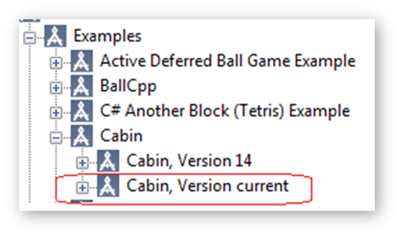
Config mgmt. - Modeler
Windchill Modeler OSLC Server
Exposes all model versions
Use to create static, version specific OSLC Links
Exposes current version (latest)
Link to these items for an OSLC Link that always point to the latest
Windchill Modeler OSLC client
Allows the creation of OSLC Links and OSLC Surrogates
Several link types can be used
Link direction can be specified (incoming, outgoing)

